Slide 1



DIGITAL MANUFACTURING
KNIFE / Comb WITH PLANETARY GEAR MECHANISM

Slide 2
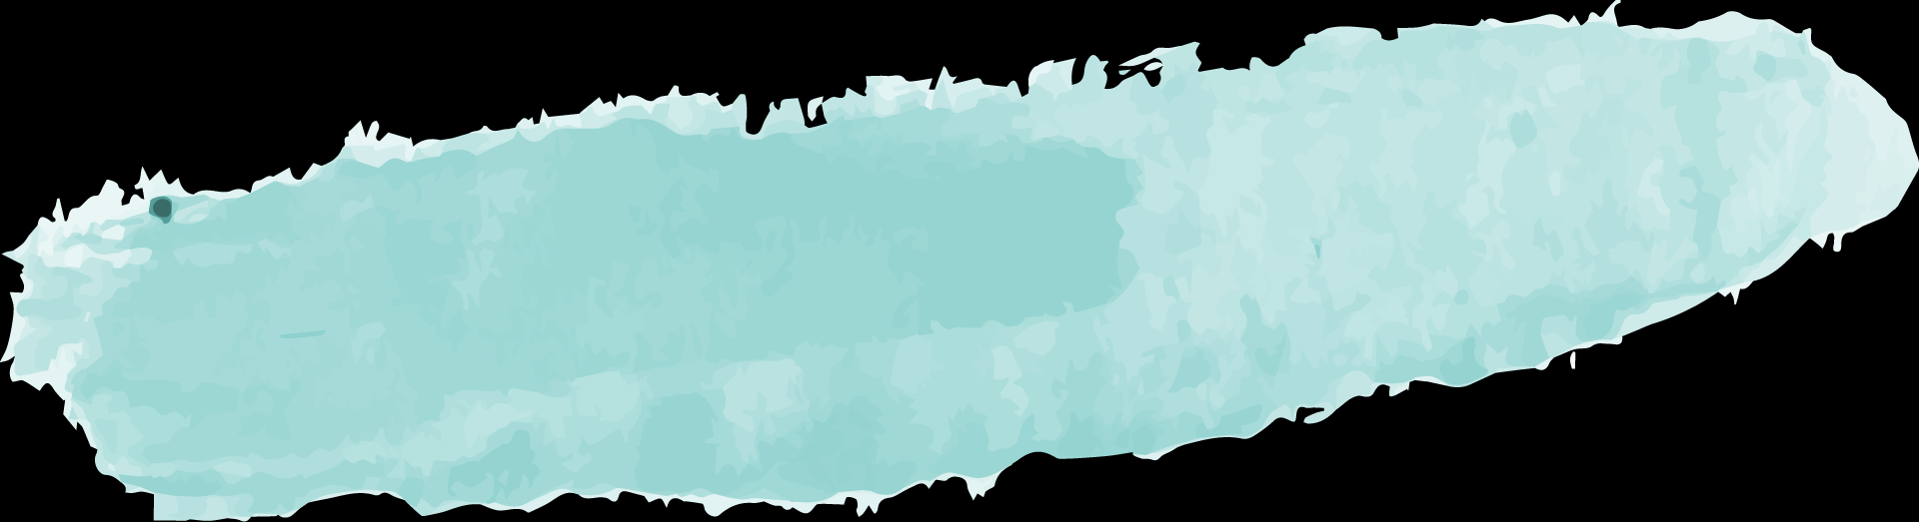
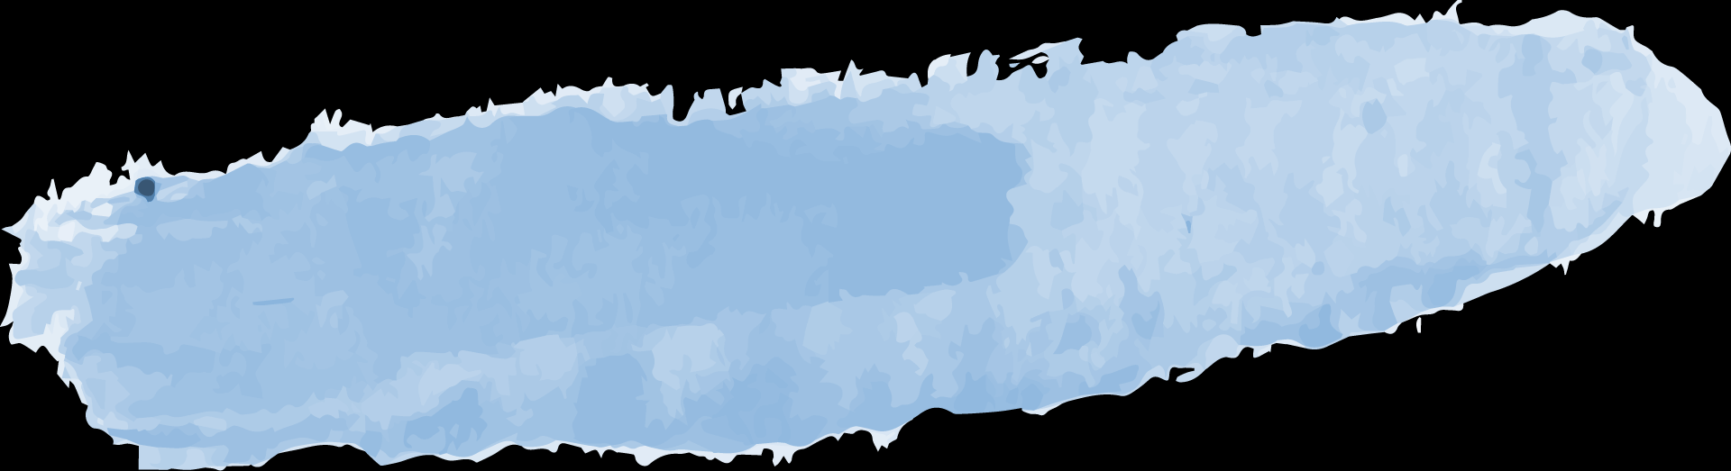
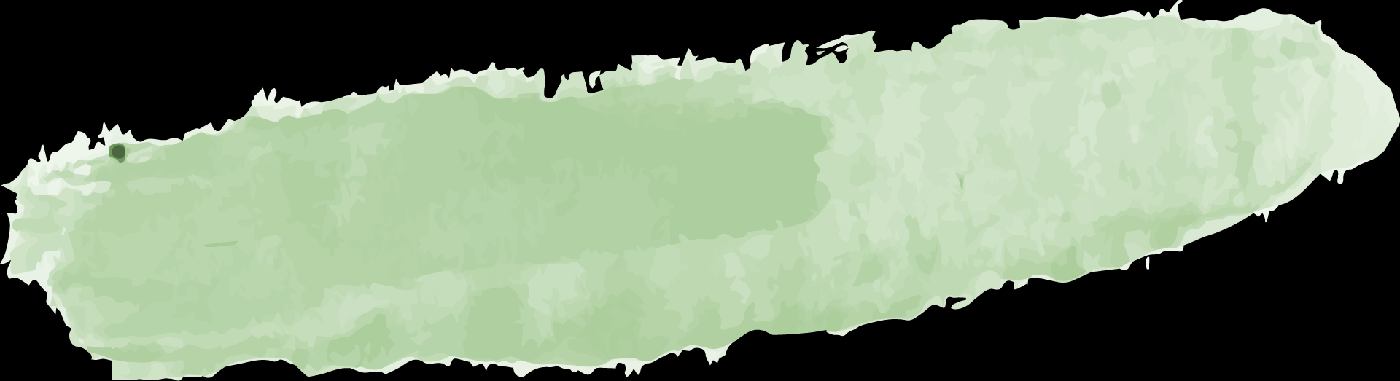
Timeline
INTRODUCTION
CURA
JUSTIFICATION
FREECAD
CODE

Slide 3
OBJECTIVE
To design a Planetary Gear
Comb / Knife

Slide 4
Introduction
MECHANISM -Planetary Gear
Sun gear drives the whole mechanism.
Whole system revolves on its own axis and along the external gear ring.
Movement of gears causes comb to move - Relieves stress
Notes:
# The Sun Gear drives the planetary gear assembled with the external gear ring to operate.
#
#The output shaft being connected to the planetary carrier ,it also revolves making the comb emerge out from the comb.
#

Slide 5
01
FREECAD
FREECAD is used to create the 3D Model

Slide 6


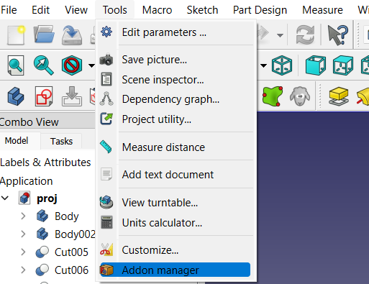
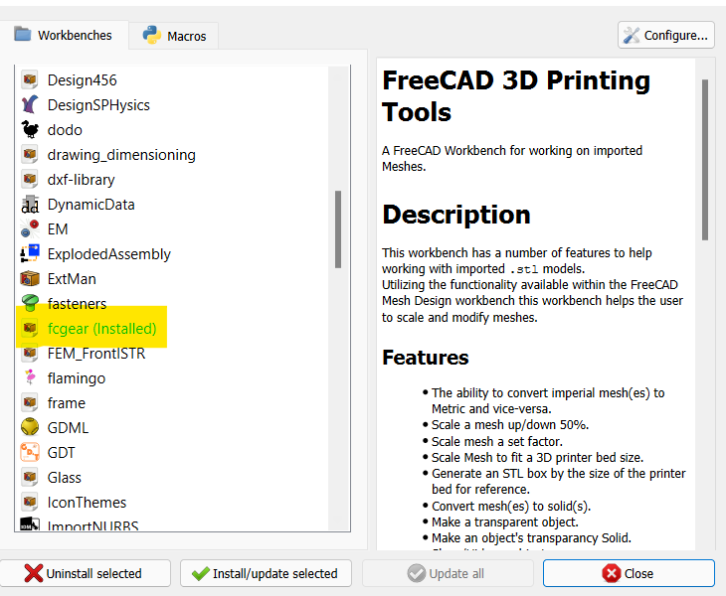
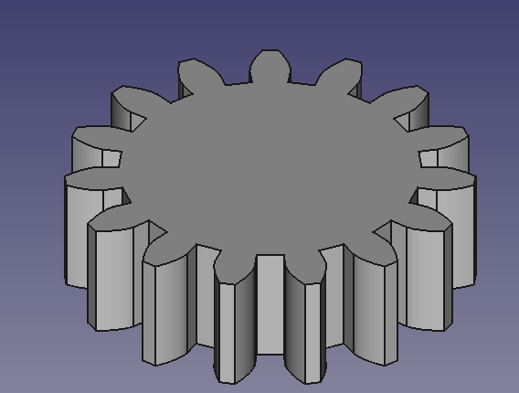


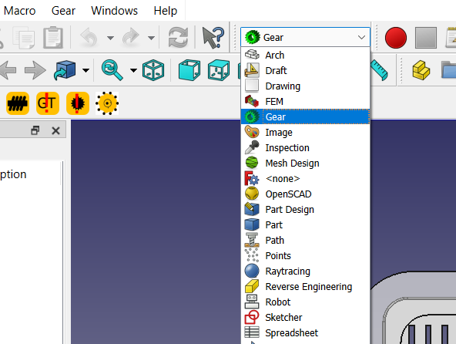
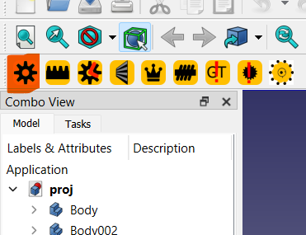
STEP 1
>
Open tools and select addon manager
Then install fcgear
>
Created GEAR
>
Then click the highlighted con to create gear
Then select GEAR

Slide 7
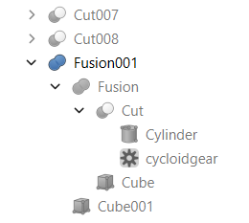
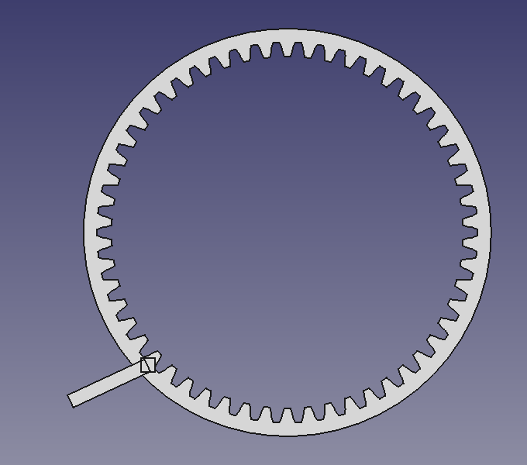
STEP 2

Slide 8
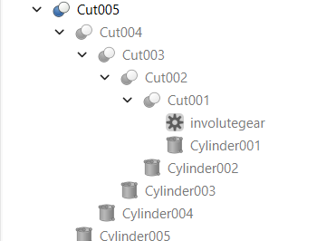

STEP 3

Slide 9
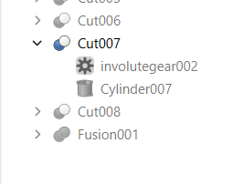
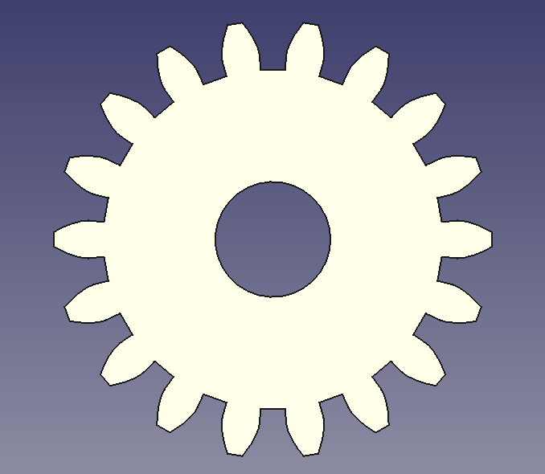
STEP 4

Slide 10
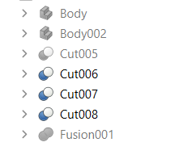
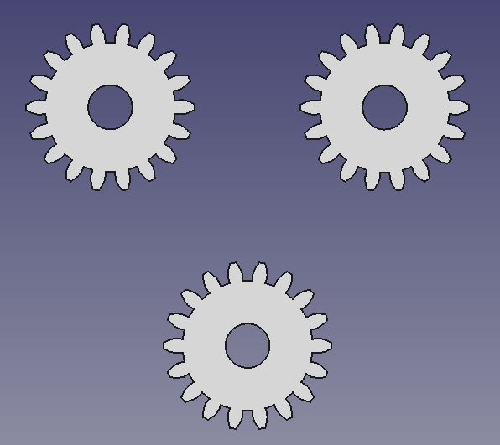
STEP 5

Slide 11
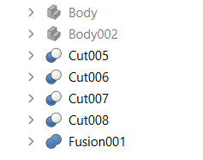
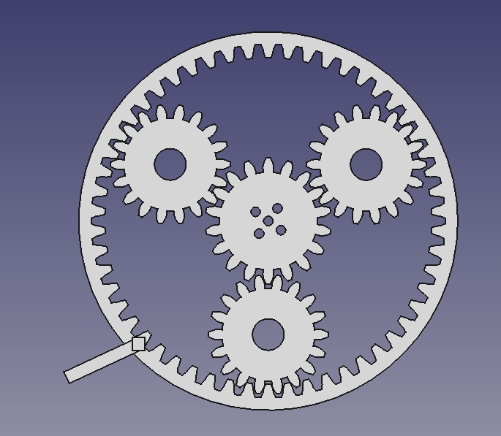
STEP 6

Slide 12
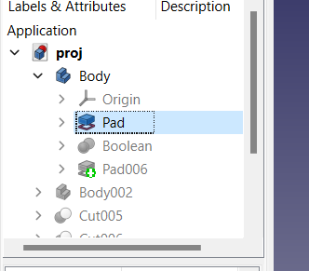
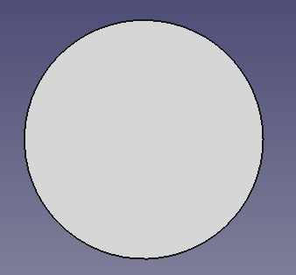
STEP 7

Slide 13
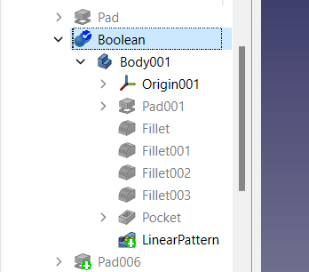
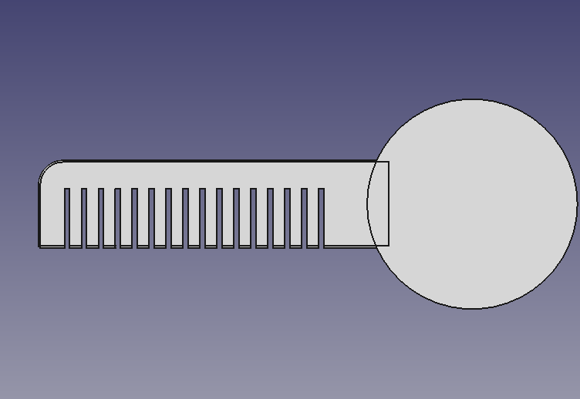
STEP 8

Slide 14
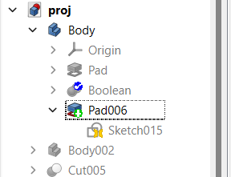
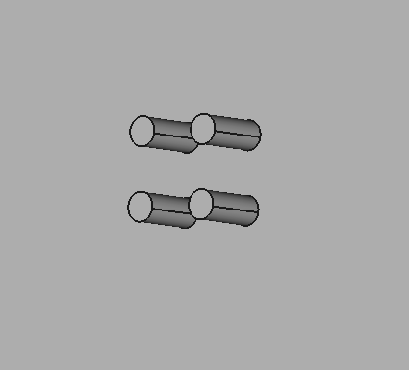
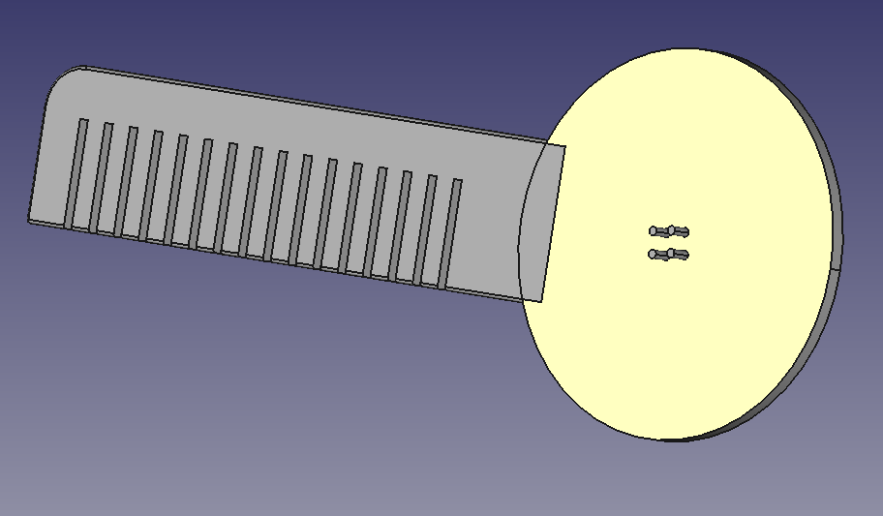

STEP 9
>

Slide 15
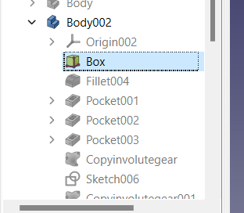
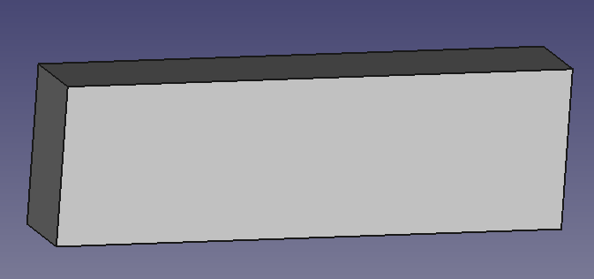
STEP 10

Slide 16
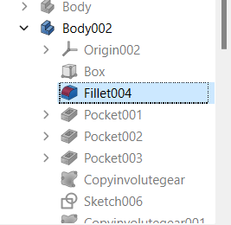
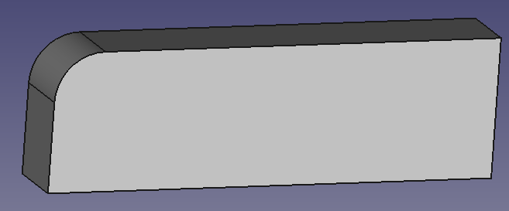
STEP 11

Slide 17
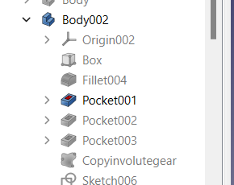
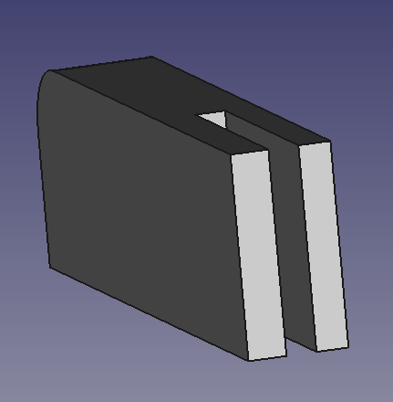
STEP 12

Slide 18
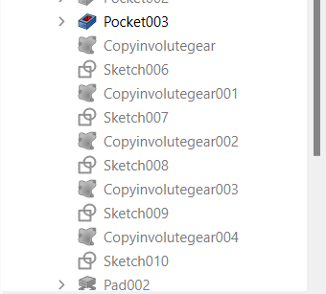
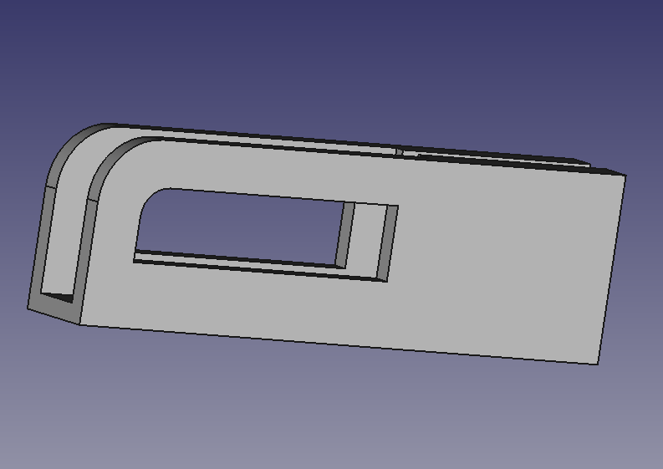
STEP 13
>

Slide 19
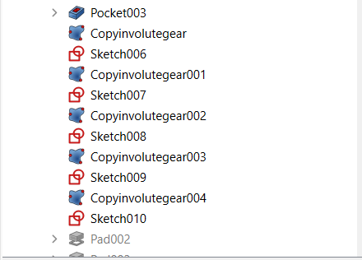
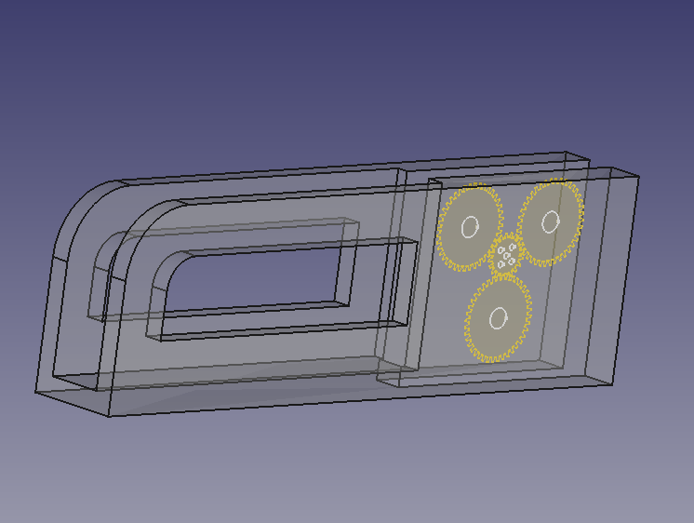
STEP 14

Slide 20
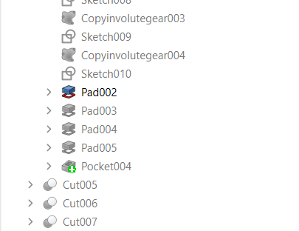
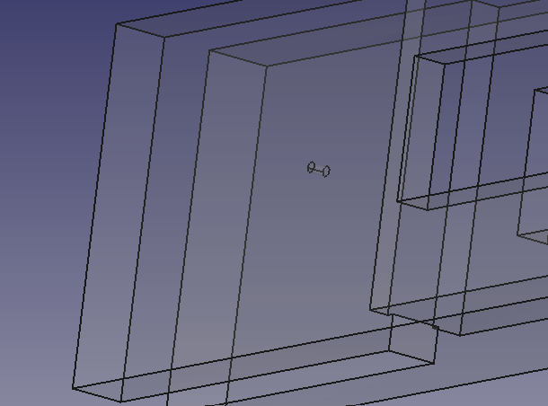
STEP 15
>

Slide 21
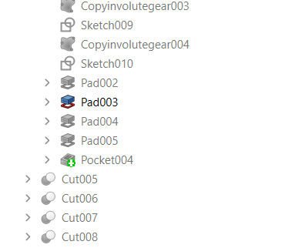
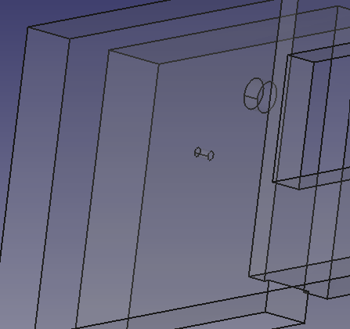
STEP 16

Slide 22
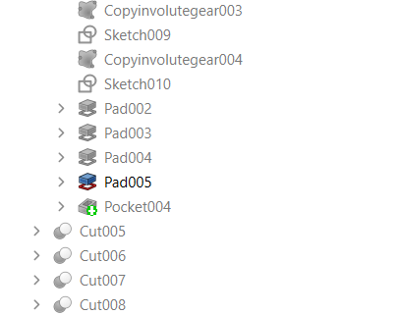
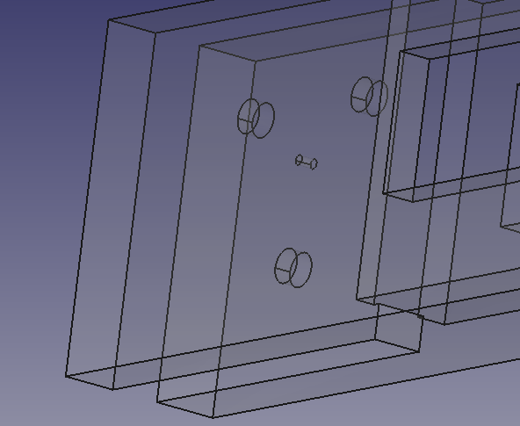
STEP 17
>

Slide 23
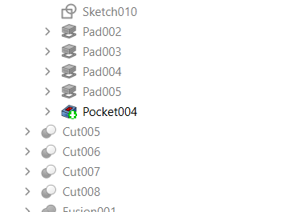
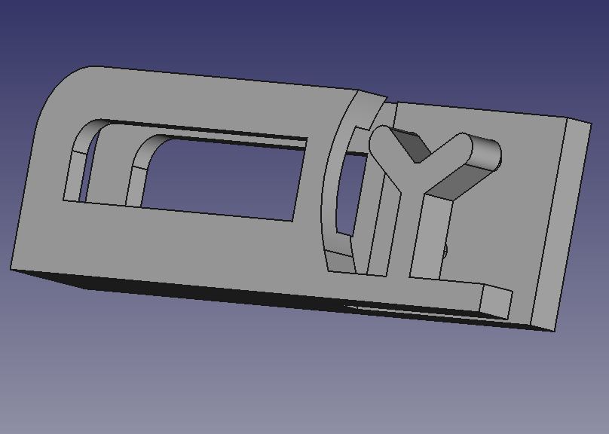
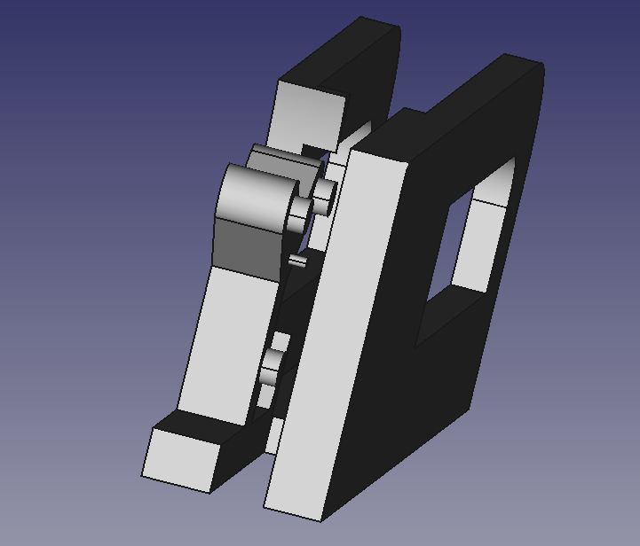
STEP 18
>

Slide 24
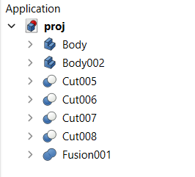
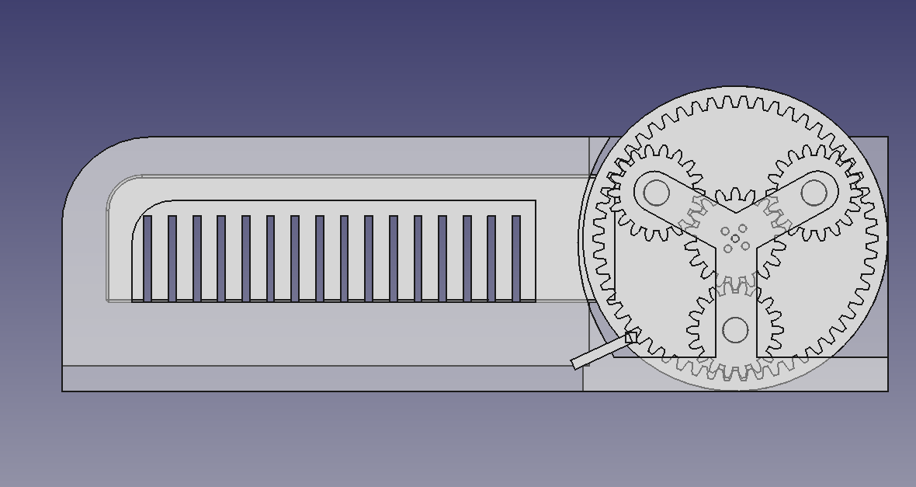
STEP 19

Slide 25
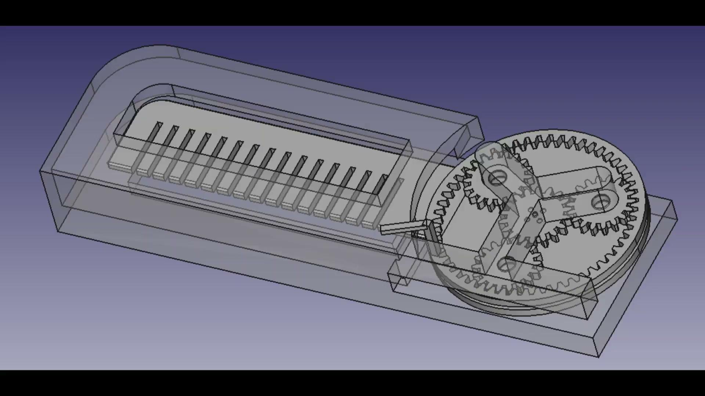
ANIMATION(full)

Slide 26
02
CURA
CURA is used for slicing

Slide 27
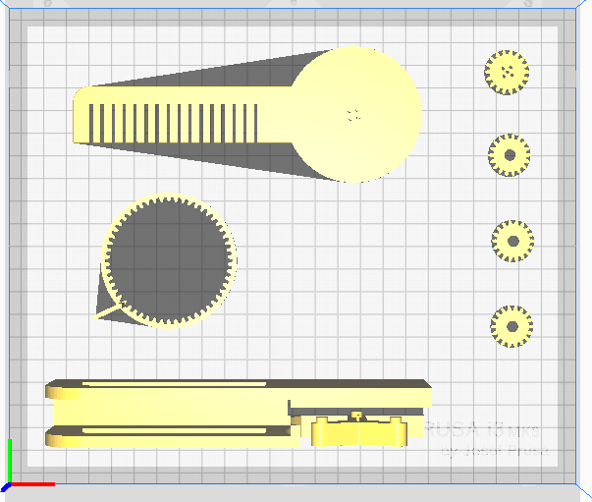

Slide 28
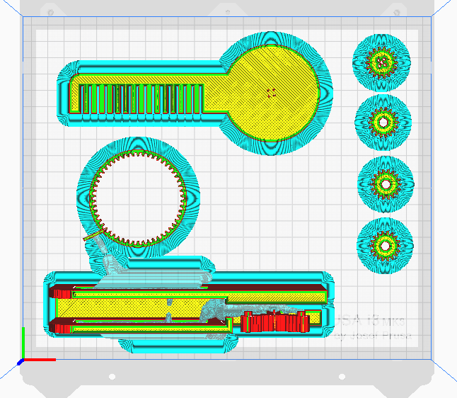
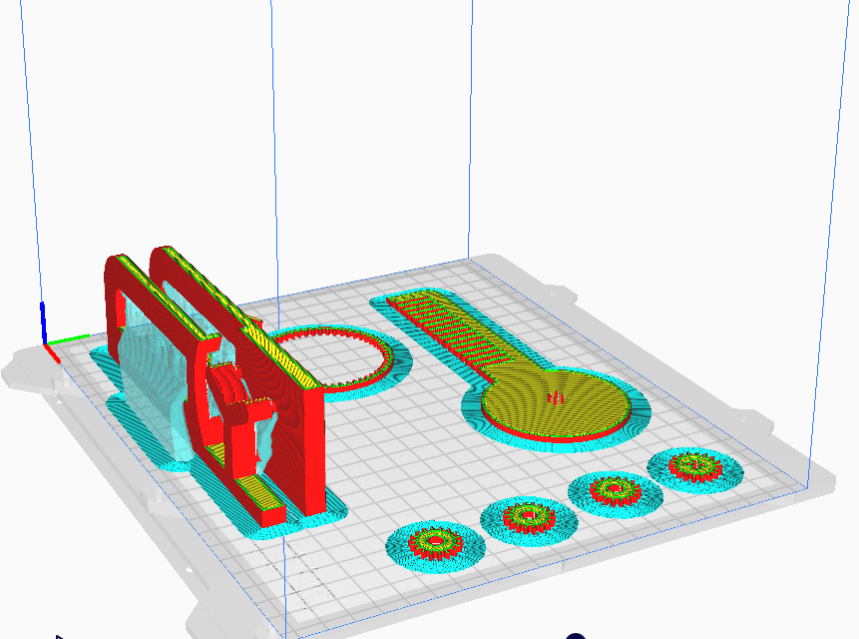

Slide 29
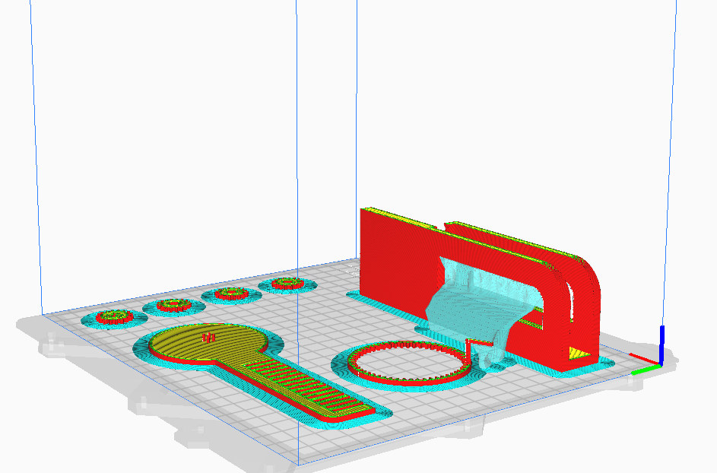
>

Slide 30


>

Slide 31


Slide 32
03
CODE
TO GIVE THE MODEL A LIFE

Slide 33


PYTHON MODULES USED
QtCore
PySide2
Modules used
QtGui
Pyside
Sub-module
Sub-module

Slide 34


MyGui Class
INITIALIZATION
Ring Gear
Sun Gear
Planetary Gear

Slide 35



CONSTRUCTOR
bt_play_click()
bt_reset_click()
bt_pause_click()

Slide 36

ACTION PERFORMED BY BUTTONS
CONNECTED TO
play()
reset()
Pause Action

Slide 37
ROTATION MADE BY EACH OF THE GEARS
Let number of teeth of sun gear be ‘m’
Let number of teeth of planet gear be ‘n’
Sun Gear
Rotation = Offset angle + r
Planetary Gear
Rotation = Offset angle + (m/n)* r
Ring Gear
Rotation = Offset angle + r
Range of motion of the gears
Sun gear 0⁰ to 180⁰
Planetary gear 0⁰ to 180⁰
Ring gear 0⁰ to 75⁰
Comb 0⁰ to 180⁰

Slide 38

play() METHOD

Slide 39

reset() METHOD

Slide 40



CALLING THE CLASS
LET US GO TO THE ANIMATION !

Slide 41

ANIMATION

Slide 42
ANIMATION

Slide 43
04
JUSTIFICATION
FOR THE CHOICE OF MODELLING AND SLICING ENABLING US TO PRINT

Slide 44
NOTABLE POINTS OF OUR MODEL

Slide 45
JUSTIFICATION FOR CHOICES OF MODELLING
>

Slide 46
JUSTIFICATION FOR CHOICES OF MODELLING

Slide 47
JUSTIFICATION FOR CHOICES OF MODELLING

Slide 48

JUSTIFICATION FOR CHOICES OF SLICING

Slide 49



JUSTIFICATION FOR USAGE OF BRIM
PREVENTION OF WARPING
GREATER BED ADHESION
EASY REMOVAL
SUPPORT FOR SUPPORT

Slide 50
EVOLUTION OF OUR MODEL
>
>
>

Slide 51
EVOLUTION OF THE MODEL
>
>
>

Slide 52
Miscellaneous Models Created

Slide 53


Slide 54


Slide 55


Slide 56


Slide 57
THANK YOU

